Slide 1
A First Simple Program
/* This is a simple Java program.
Call this file "Example.java".*/
class Example {
// Your program begins with a call to main().
public static void main(String args[]) {
System.out.println("This is a simple Java program.");
}
}

Slide 2
Compiling the Program
C:\>javac Example.java
The javac compiler creates a file called Example.class that contains the bytecode version of the program
The output of javac is not code that can be directly executed

Slide 3
To actually run the program, you must use the Java interpreter, called java.
C:\>java Example
When a class member is preceded by public, then that member may be accessed by code outside the class in which it is declared

Slide 4
The keyword static allows main( ) to be called without having to instantiate a particular instance of the class
The keyword void simply tells the compiler that main( ) does not return a value

Slide 5
A Second Short Program
class Example2 {
public static void main(String args[]) {
int num; // this declares a variable called num
num = 100; // this assigns num the value 100
System.out.println("This is num: " + num);
num = num * 2;
System.out.print("The value of num * 2 is ");
System.out.println(num);
}
}

Slide 6
Two Control Statements
The if Statement:
if(condition) statement;
if(num < 100)
System.out.println("num is less than 100");

Slide 7
The for Loop:
for(initialization; condition; iteration) statement;
class ForTest {
public static void main(String args[]) {
int x;
for(x = 0; x<10; x = x+1)
System.out.println("This is x: " + x);
}
}

Slide 8
Using Blocks of Code:
using { and }
Write java programs to do the following
Find sum of the digits of number3456
Find if 11211 is palindrome.

Slide 9
Lexical Issues
Whitespace:
  Java is a free-form language
  In Java, whitespace is a space, tab, or newline
Identifiers:
- Identifiers are used for class names, method names, and variable names
- Java is case-sensitive

Slide 10
Identifier naming rules
Should not begin with a number
Any descriptive sequence of uppercase,lowercase,numbers,_,$ characters

Slide 11
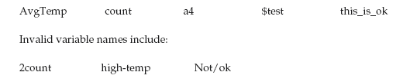

Slide 12

Literals:
A constant value in Java is created by using a literal representation of it

Slide 13
Comments
There are three types of comments defined by Java.
Single-line and multiline
The third type is called a documentation comment
This type of comment is used to produce an HTML file that documents your program
The documentation comment begins with a /** and ends with a */

Slide 14
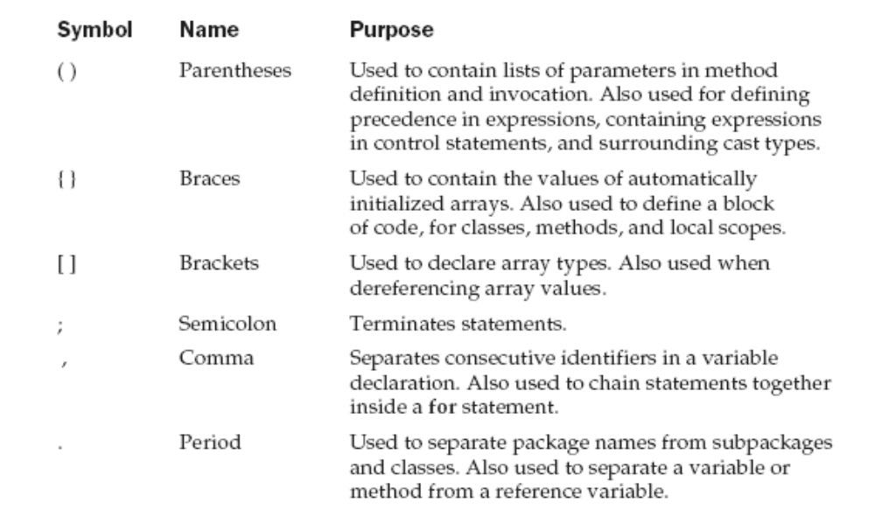
Separators

Slide 15
The Java Keywords
There are 49 reserved keywords currently defined in the Java language

Slide 16
